Slide 1
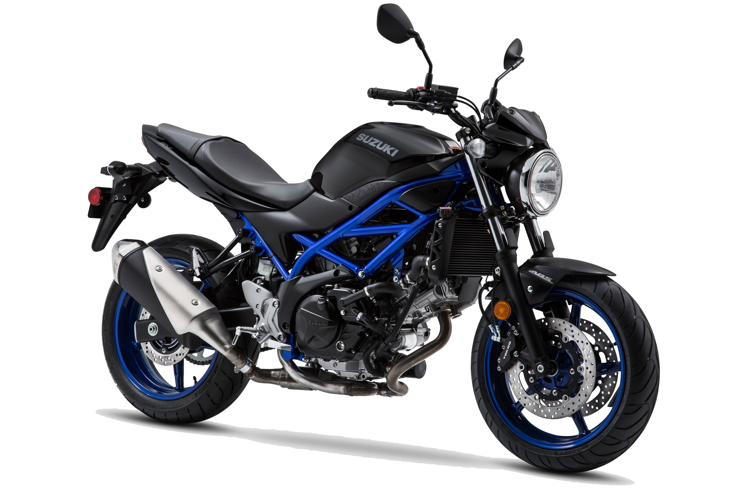
Motorists App
Keeping track of maintenance.
By Stella Enfield
Project Duration:
2 Months
Tools:
Miro, Figma, Mobbin, Lookback & Unbounce
Photo from twowheel.co.uk

Slide 2
We need a better way to manage our vehicles
Keeping all your vehicle’s logs and schedules together in a tidy and informative way can be a challenge and this app is aimed at resolving and improving life for its users.
Three people have specifically expressed a desire for an app which could help them organize their motoring lives. One had stated how their paperwork was not well organized and can be confusing to find the information they want. Another was keen on the schedules to keep on top of their servicing. The third was interested in being notified when tasks were due.
Photo by Sharon McCutcheon on Unsplash

Slide 3
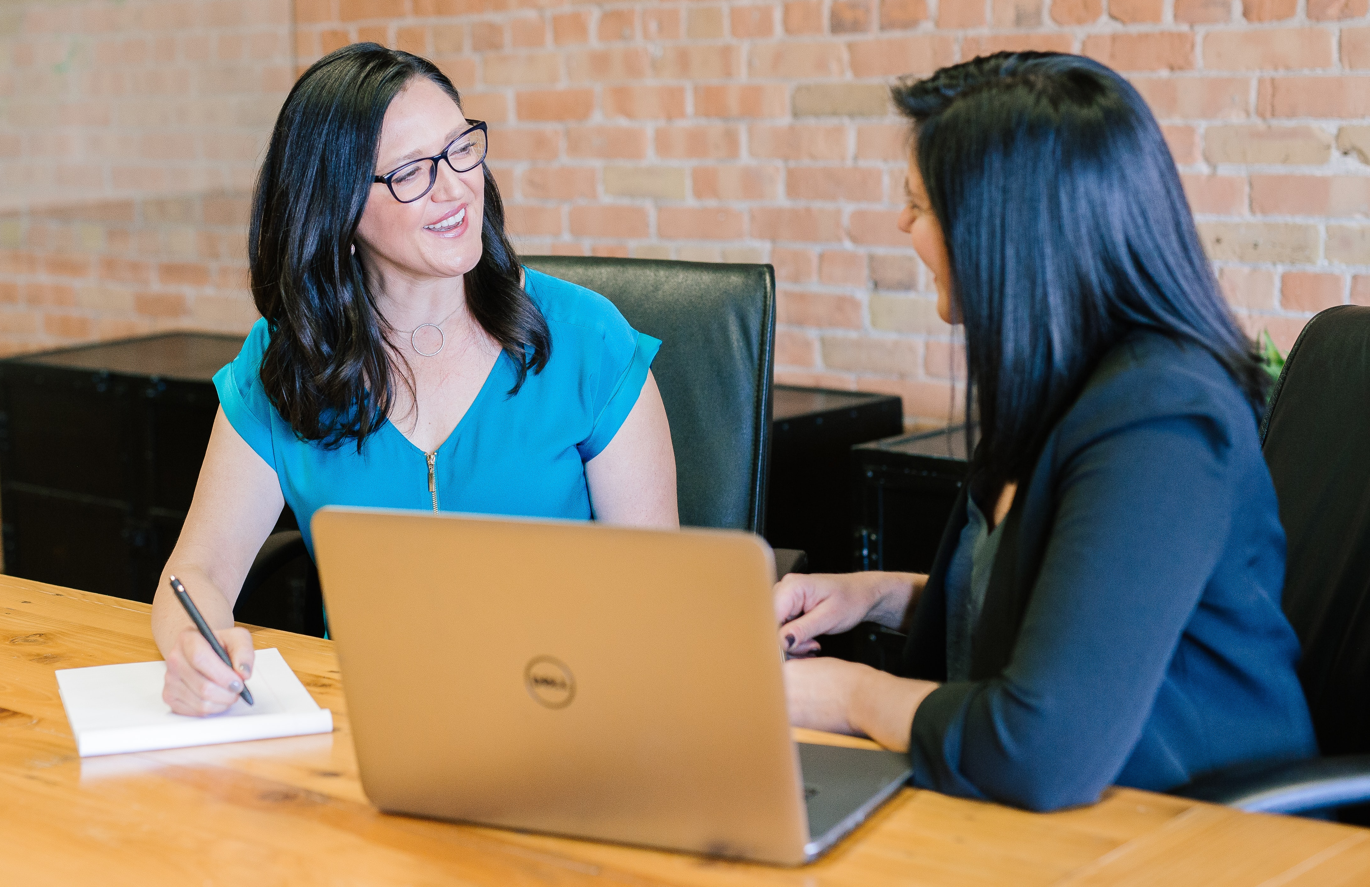
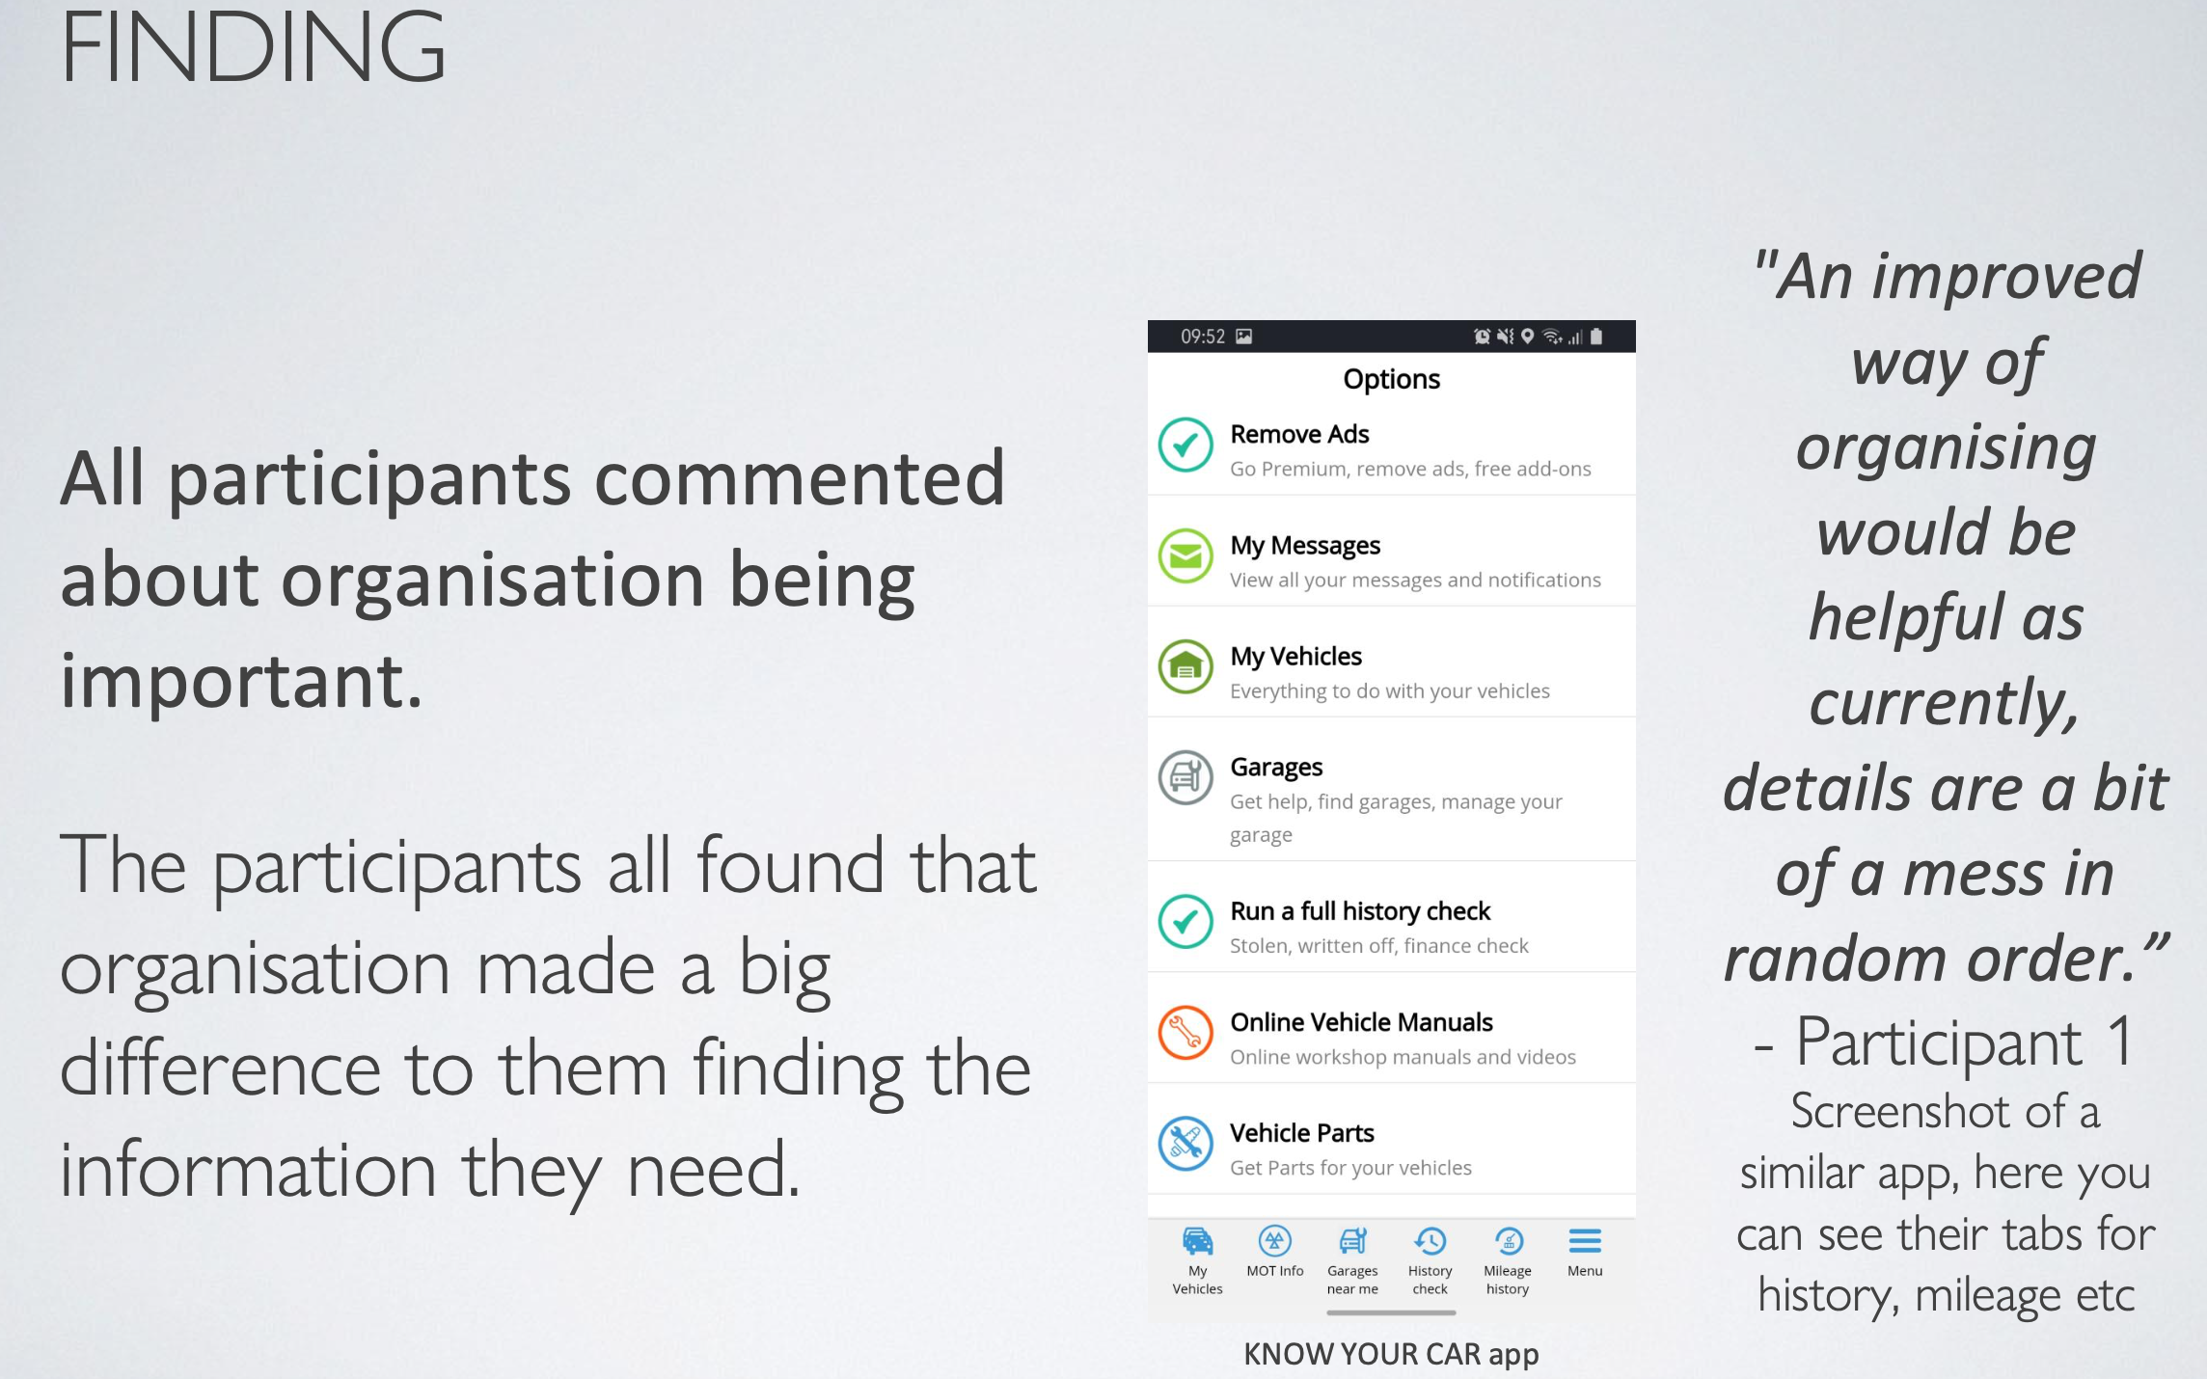
Discovery:
Research & Analysis
To determine if there was a gap in the market for an app for motorists, I conducted some research in the form of interviews and surveys.
The data I collected showed that motorists use some form of calendar to keep them up to date with maintenance schedules and generally like to check in the morning but they don’t have the level of organisation alerting that they would like.

Slide 4
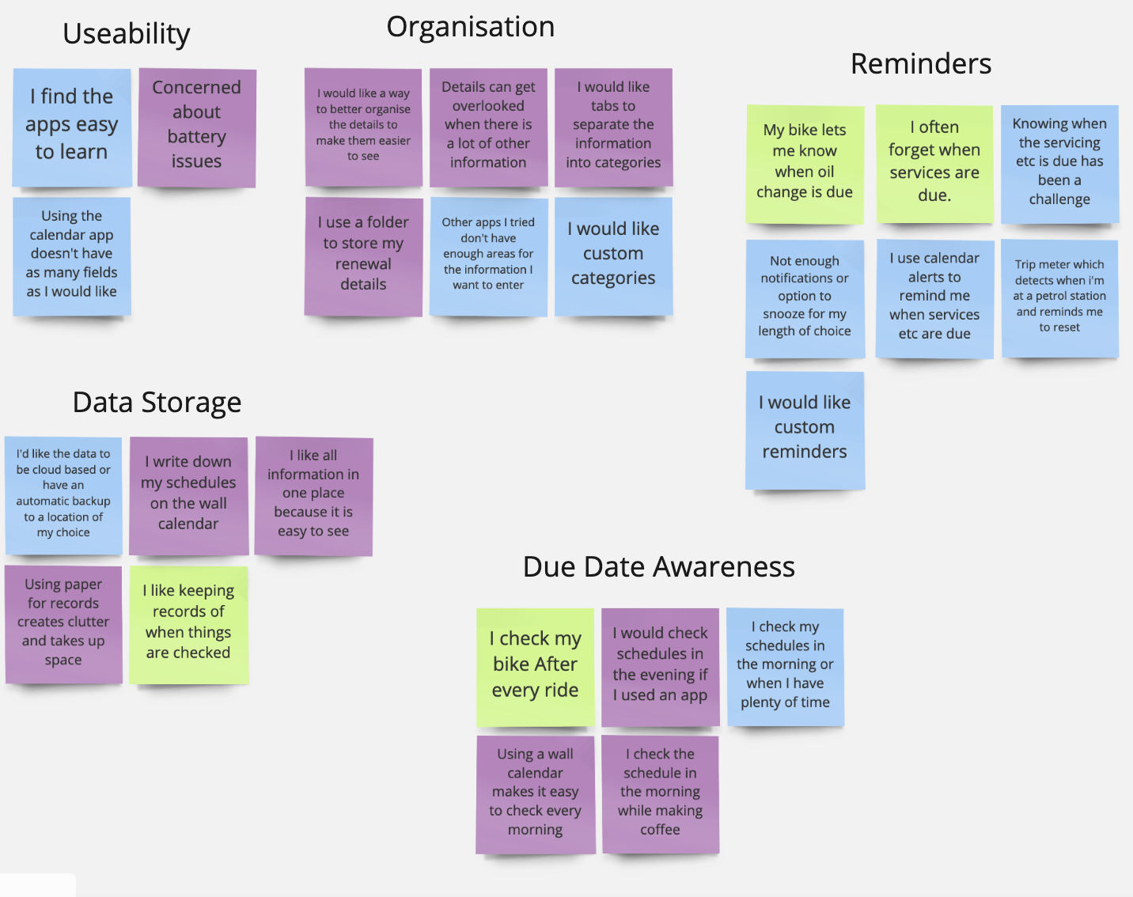
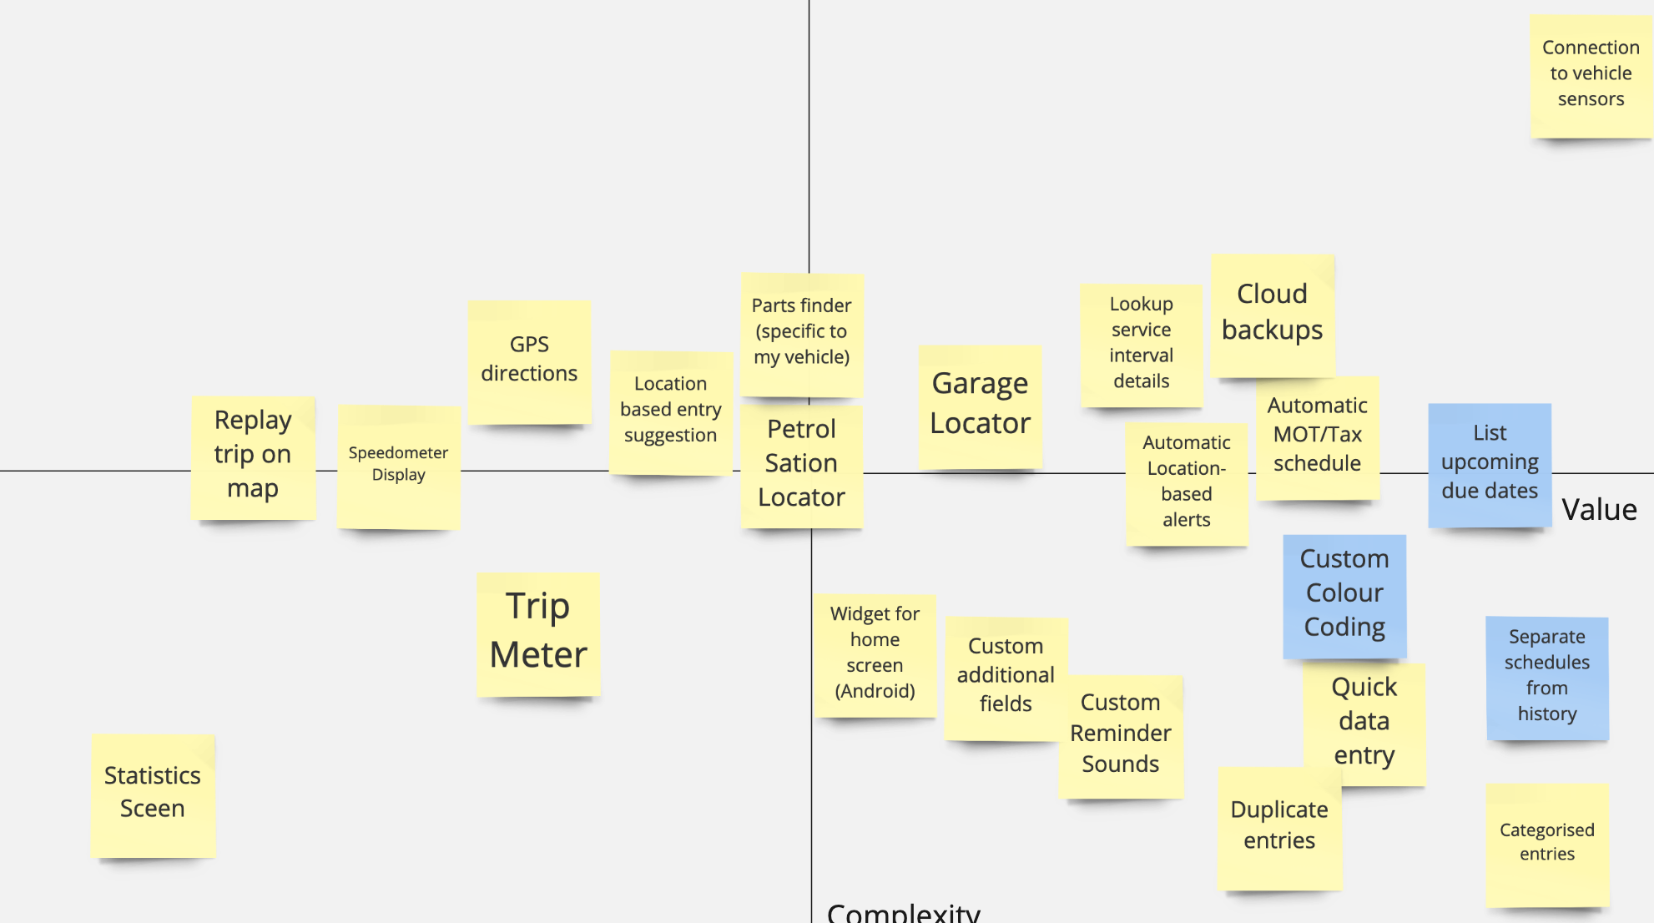
Design: Concepts & Sketching
From the interview notes I gathered, I organised them into themes using Miro and then brainstormed some features based on where the interview responses converged. I then went on to feature prioritization; plotting the features onto a grid to determine which items to focus on.
Here you can see I have decided on:
Custom colour coding
Upcoming due dates
Separate schedules and historical logs
These were chosen due to the higher value and low to medium complexity.

Slide 5
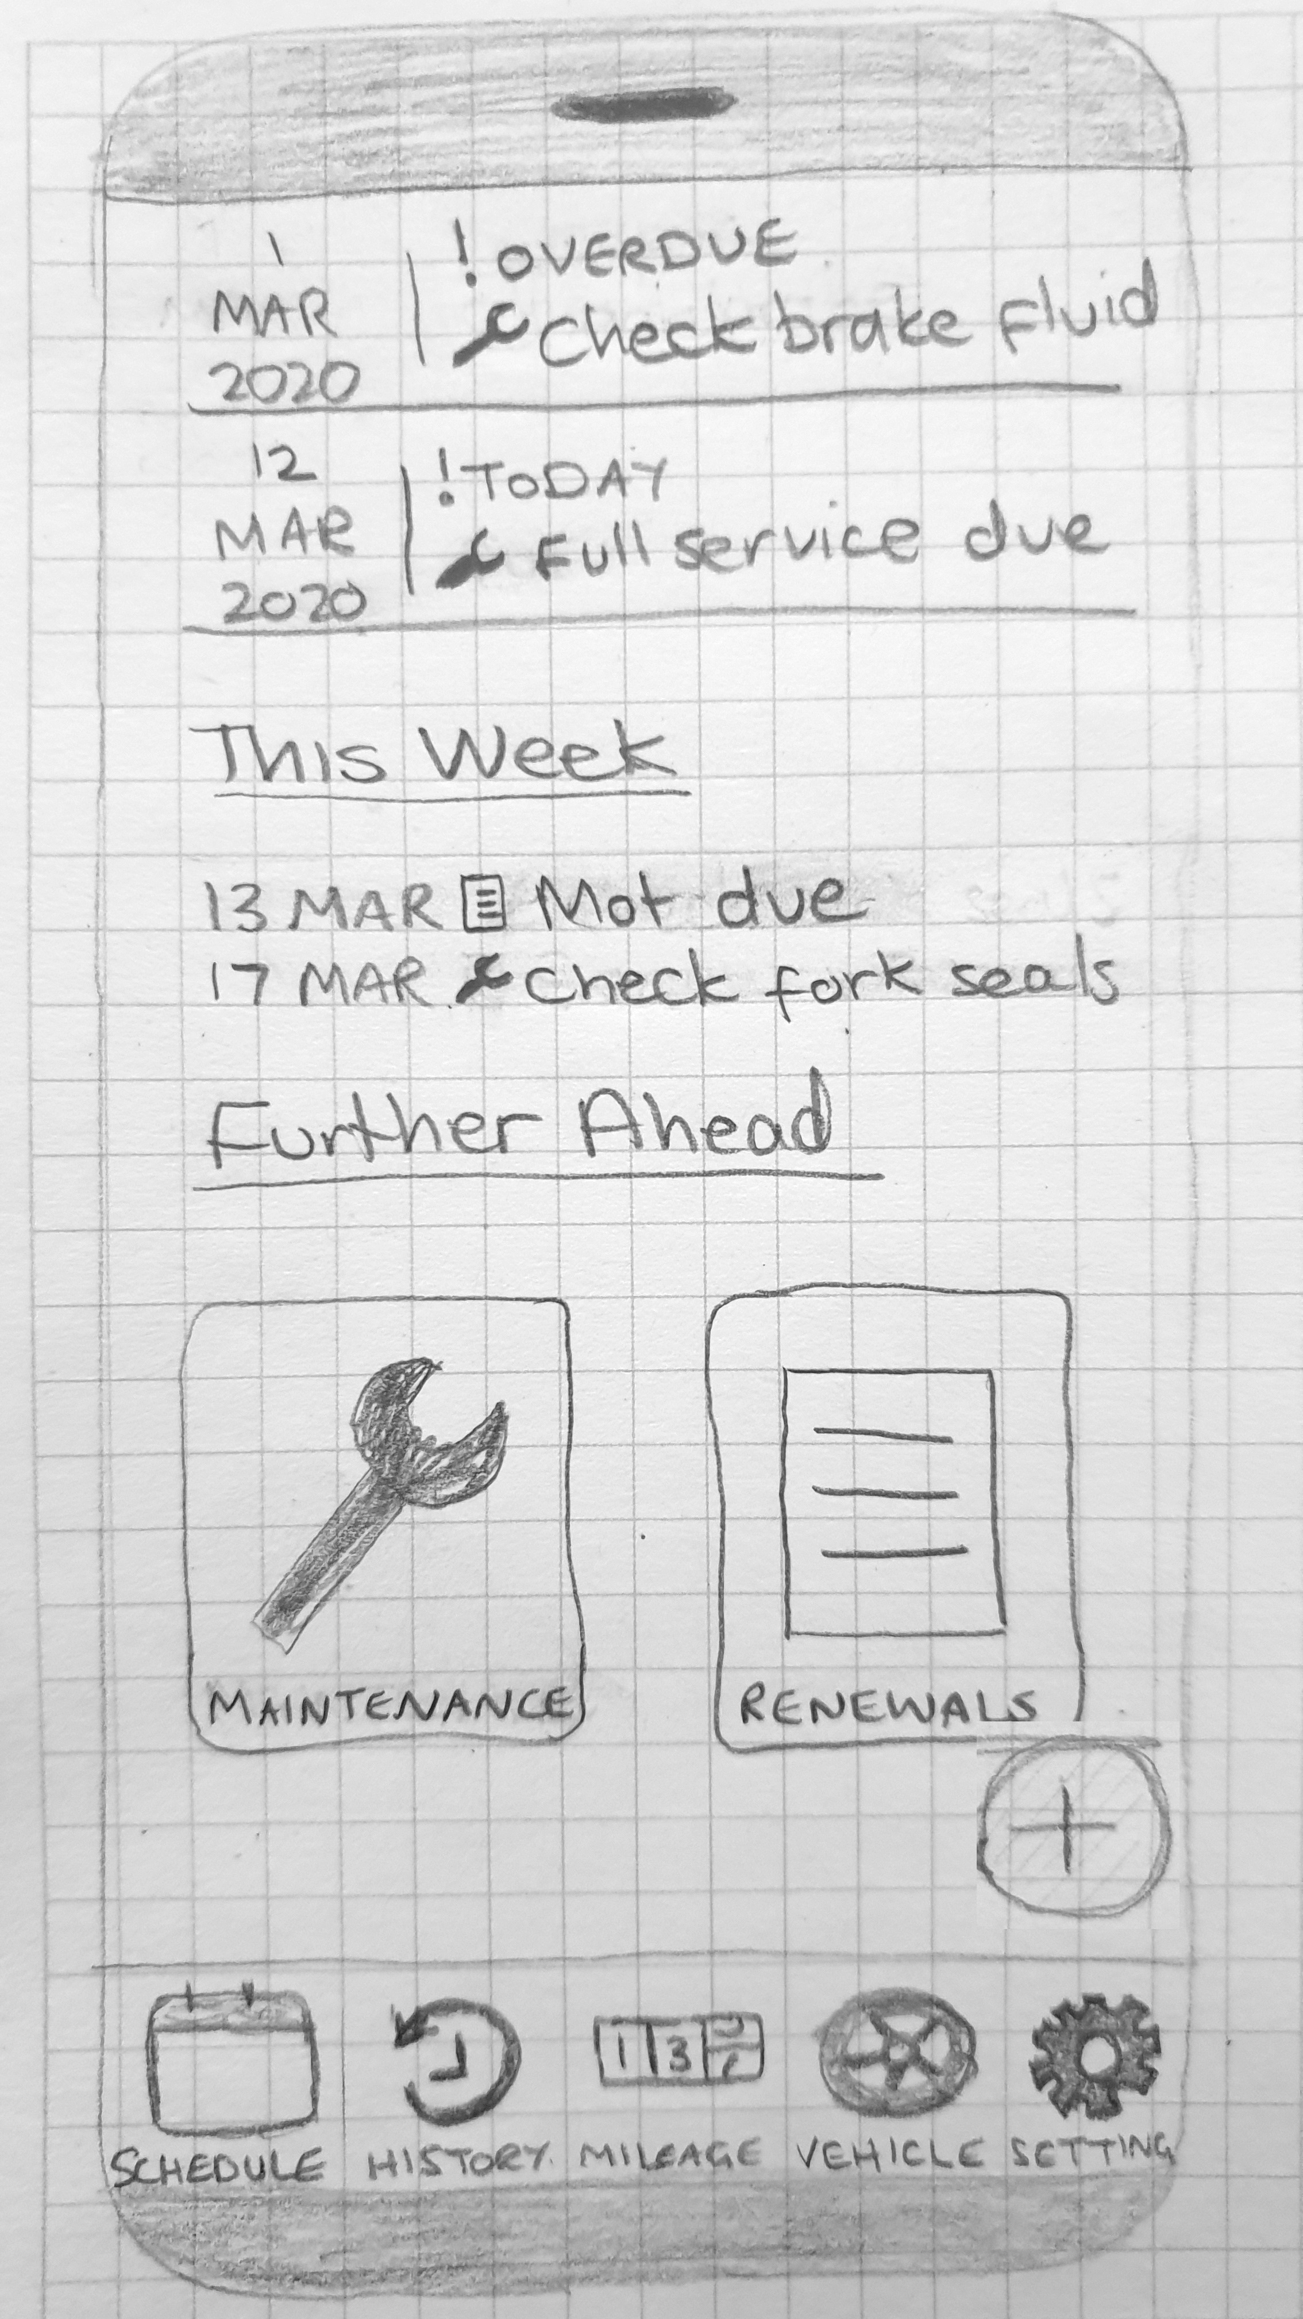
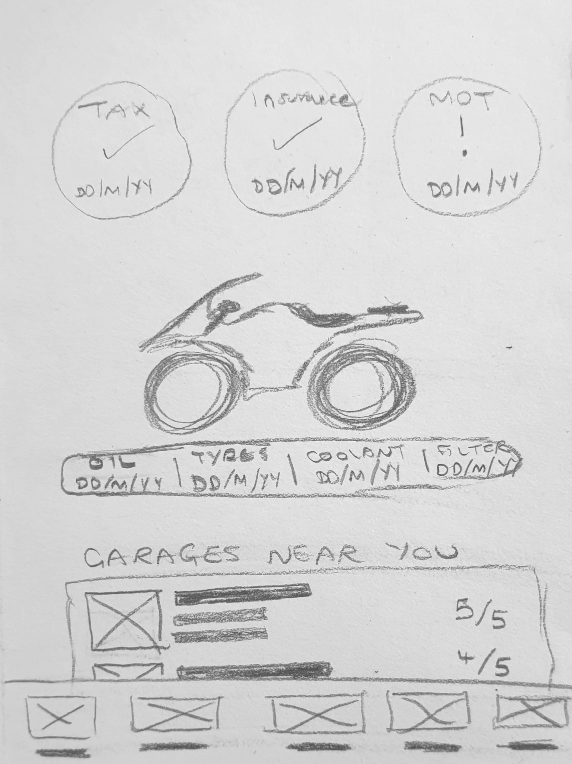
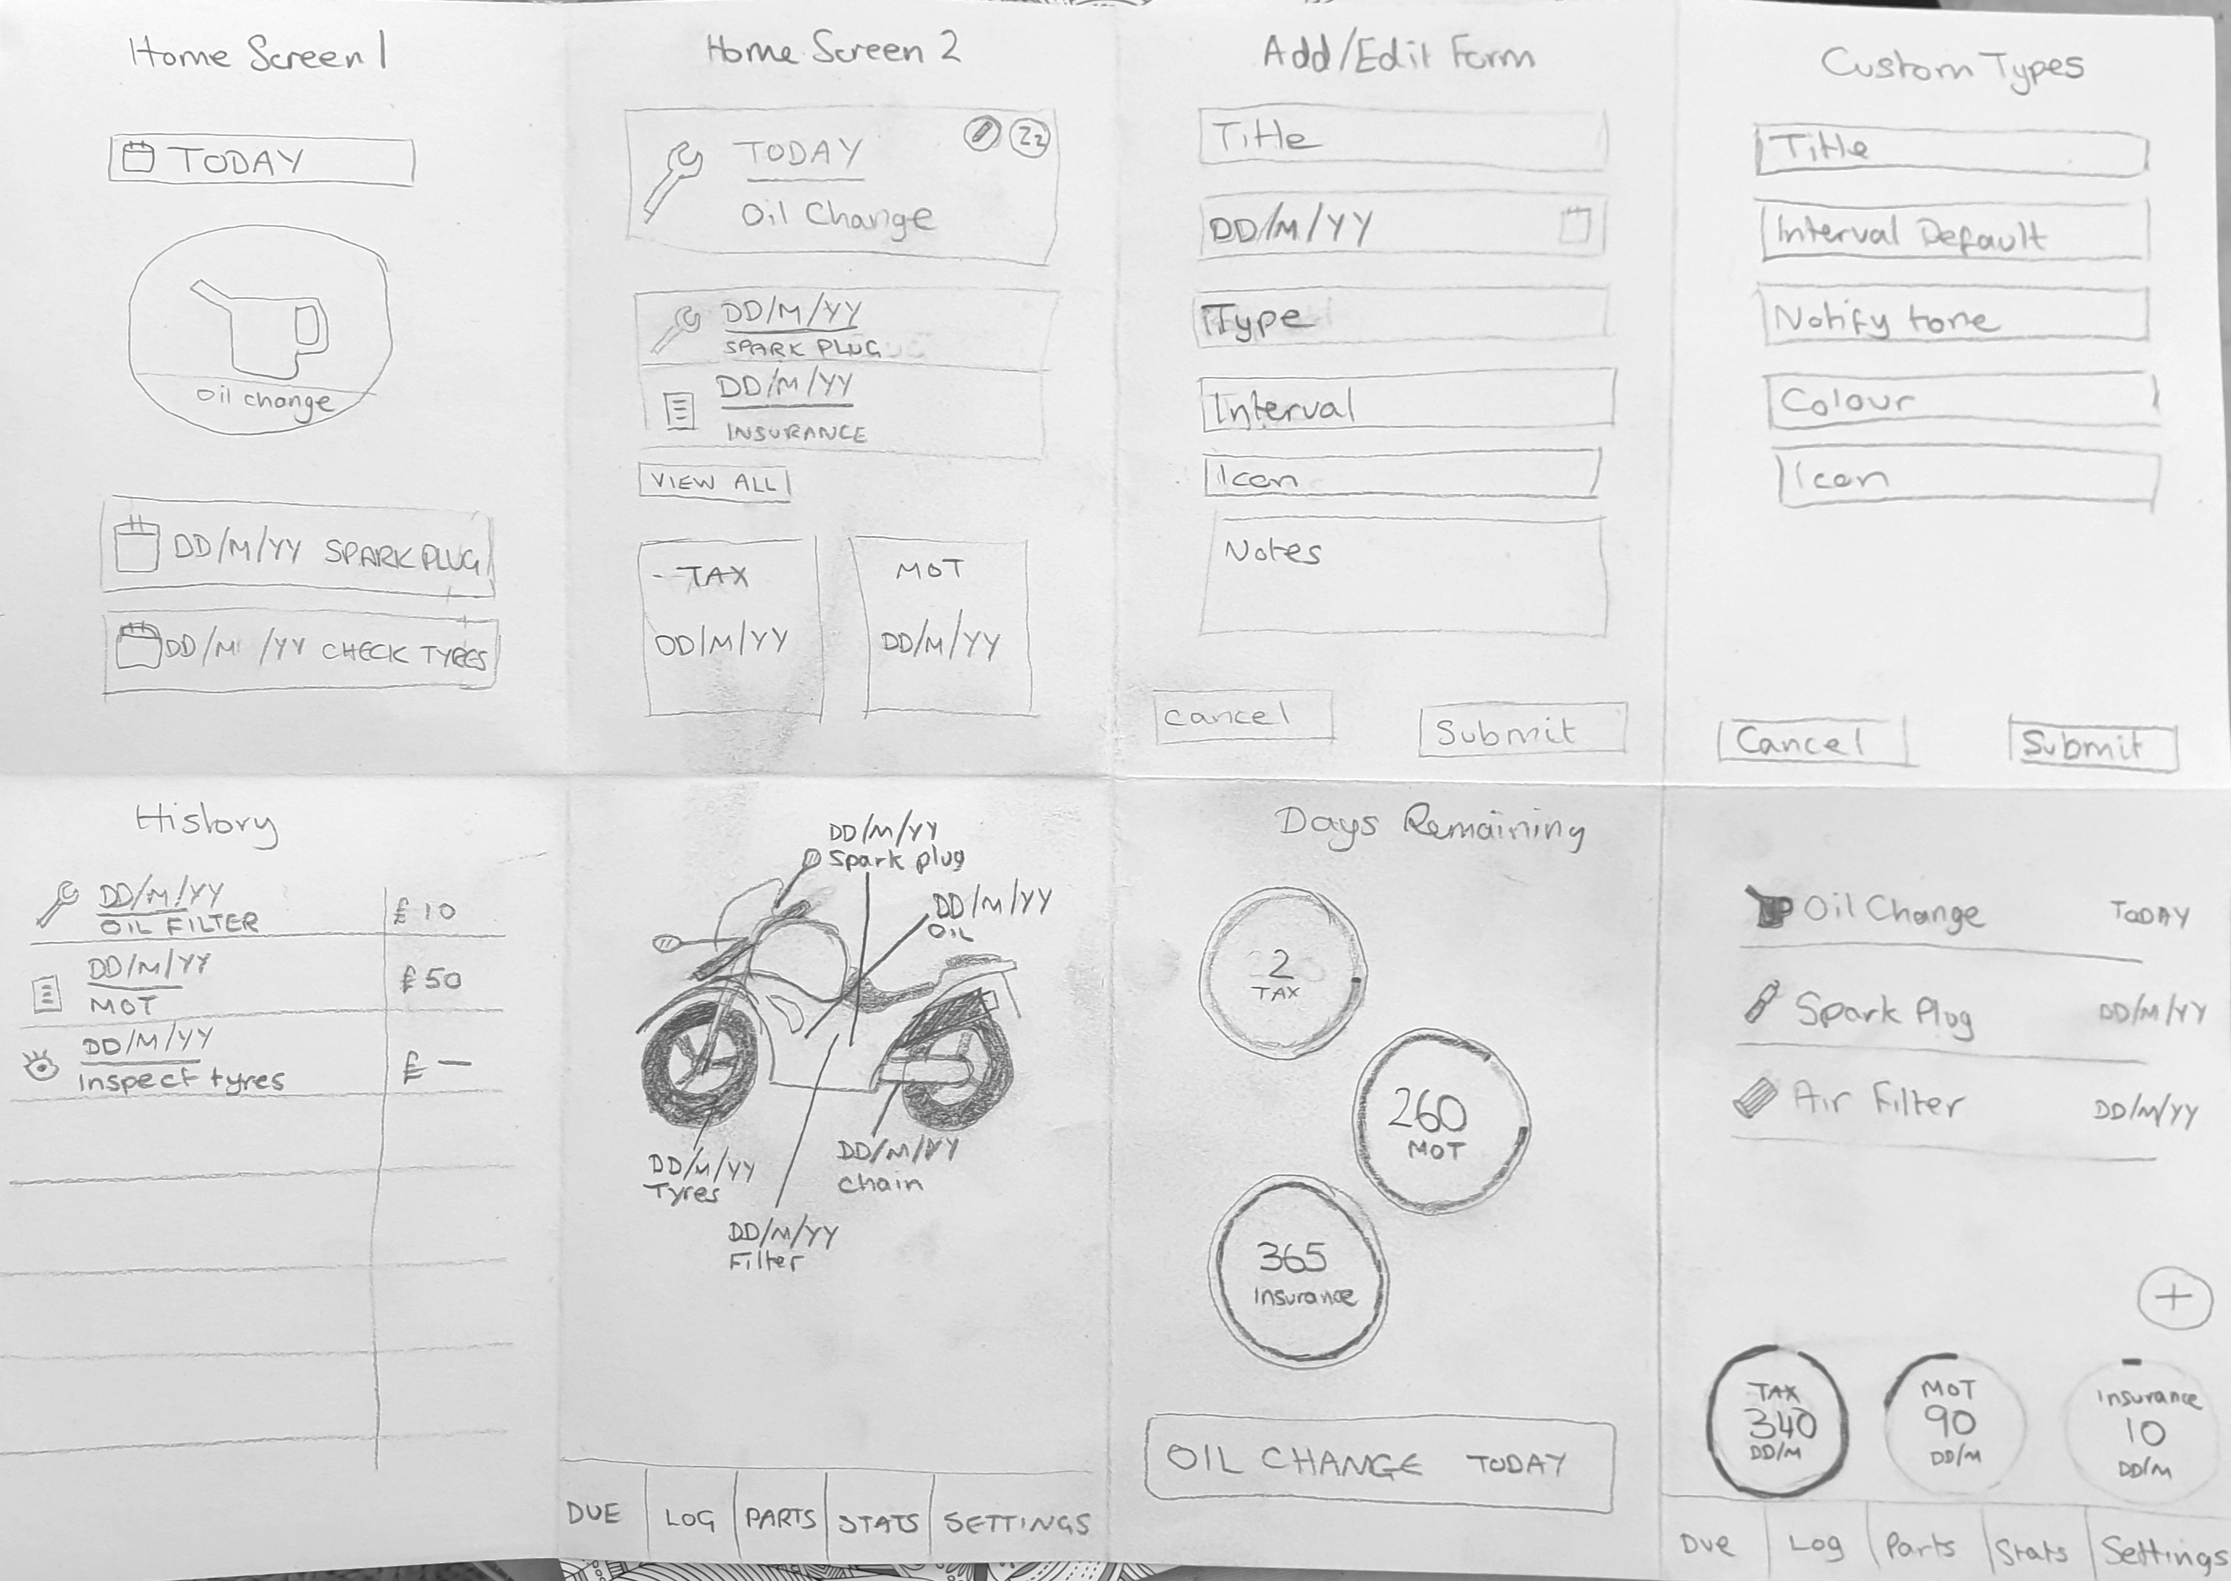
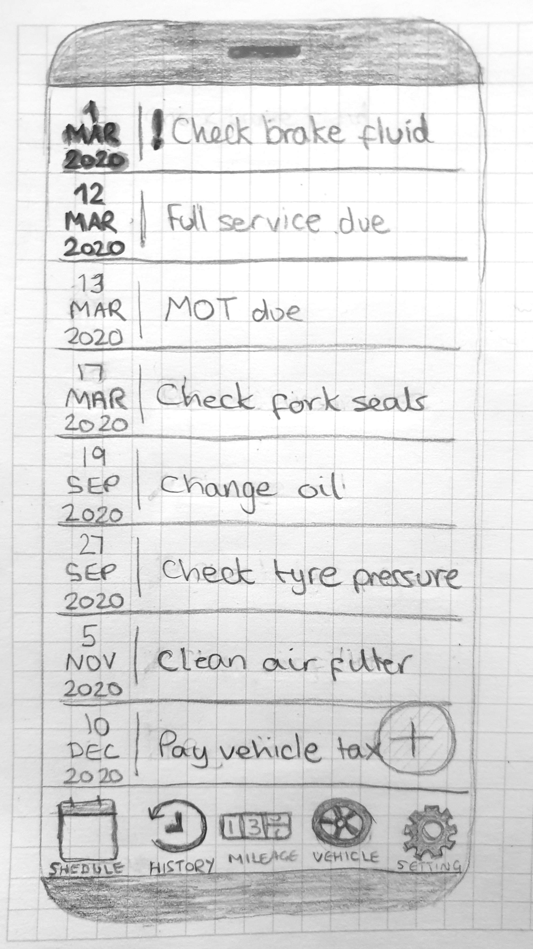
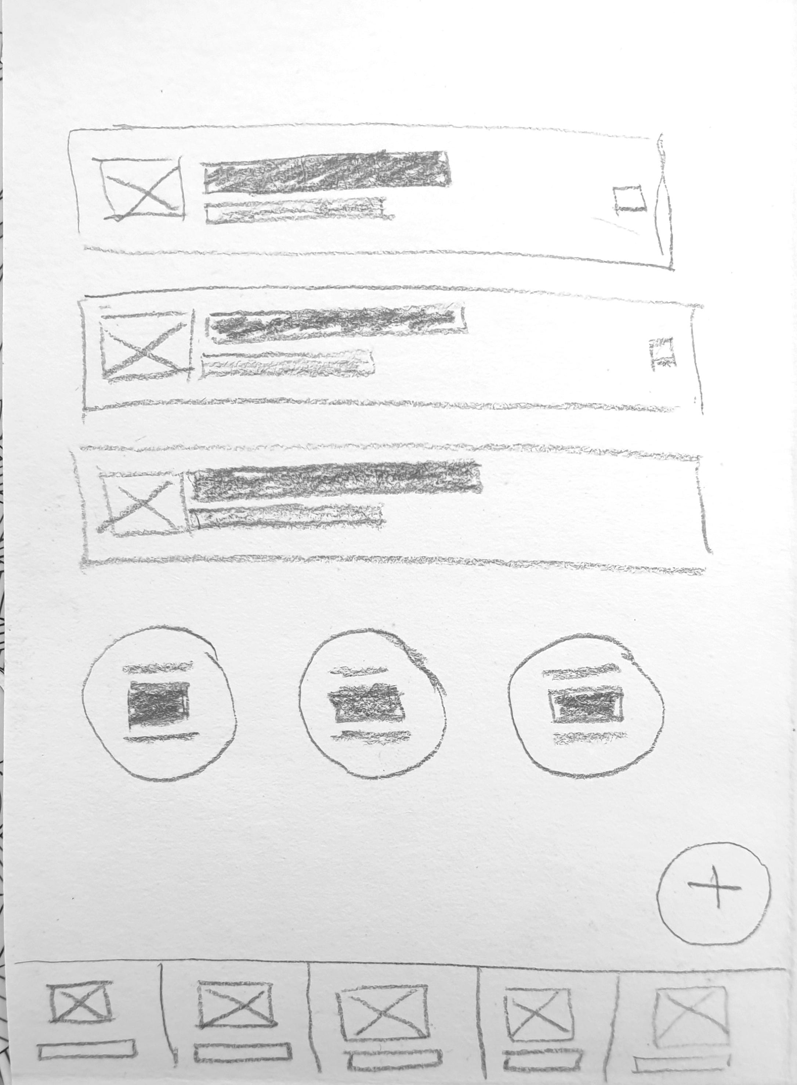
Initial Sketches

Slide 6
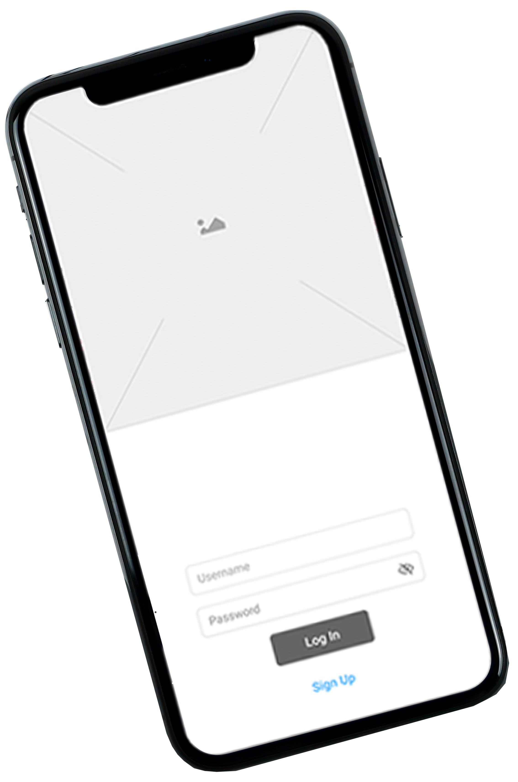
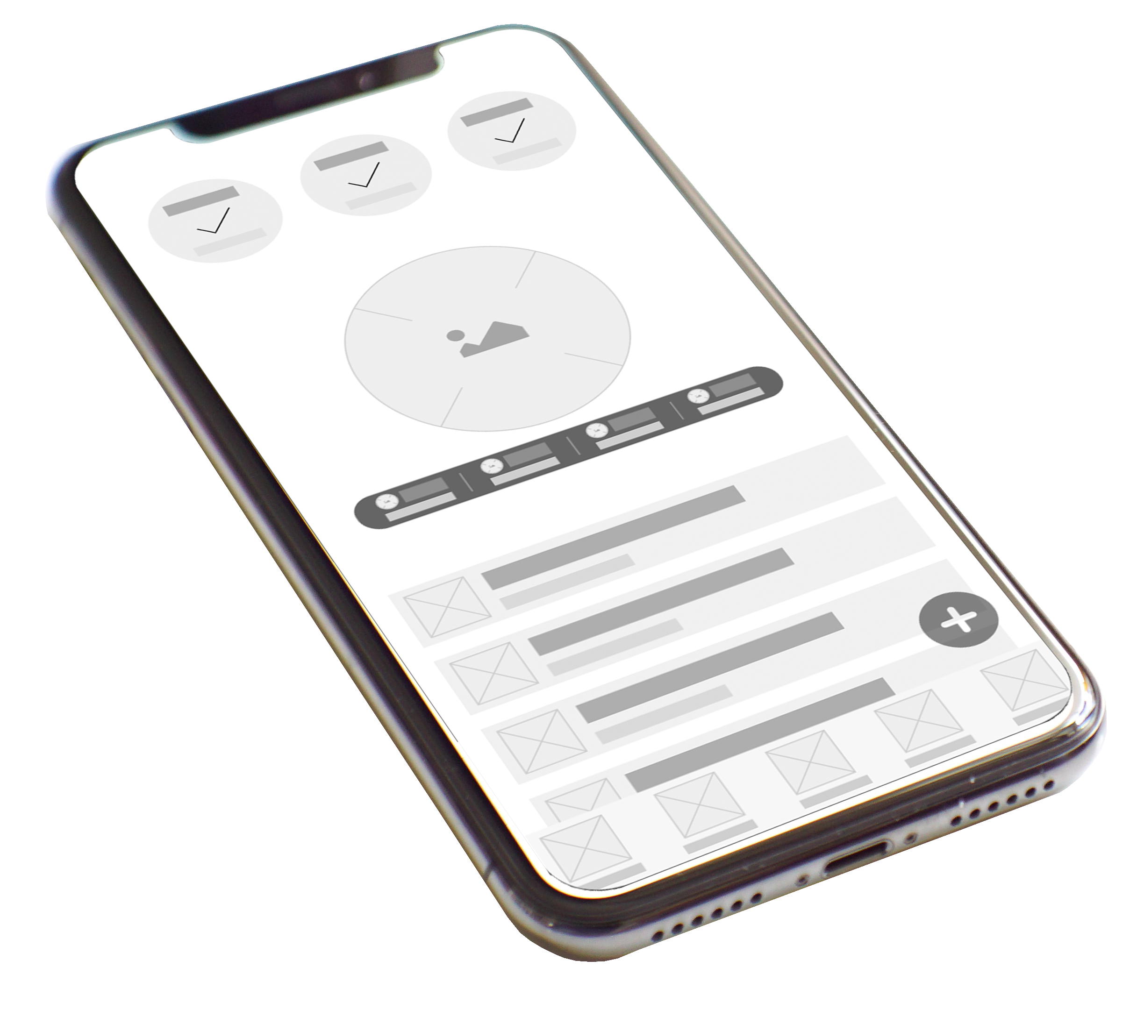
Develop: Prototyping
To the right are two screens from the initial digital proof of concept created in Figma. The image on the right is for a login screen and on the left it the main schedules screen, this displays three main items along the top (they will be MOT, Tax and Insurance). It has a list of upcoming tasks and a central area for the common maintenance items.
As these are initial designs, they have been made in low-fidelity to get feedback on the general direction and features. I used a UI Kit for the buttons, fields and image placeholders.
Click here to view this Prototype

Slide 7
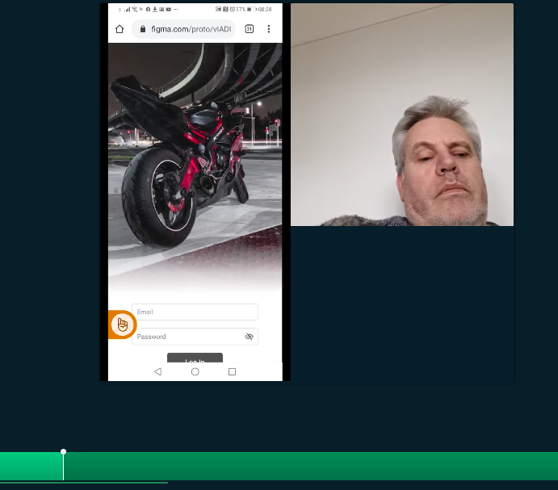
Test: Validation, Usability, Feedback
Using a combination of in person and remote (using Lookback) testing sessions, I was able to identify some key areas for improvement.
Users were asked to sign up an account and then log in. The main insights from testing are that the sign up wasn’t clear and the prototype was taller than most people’s devices. The scrolling list of tasks was given only a small space.
40% Users logged in instead of signing up.
100% Users attempted tapping non-clickable elements.
Some users reported the scrolling was annoying.
The Lookback screen was hiding the lower portion of the app.
100%
25%

Slide 8
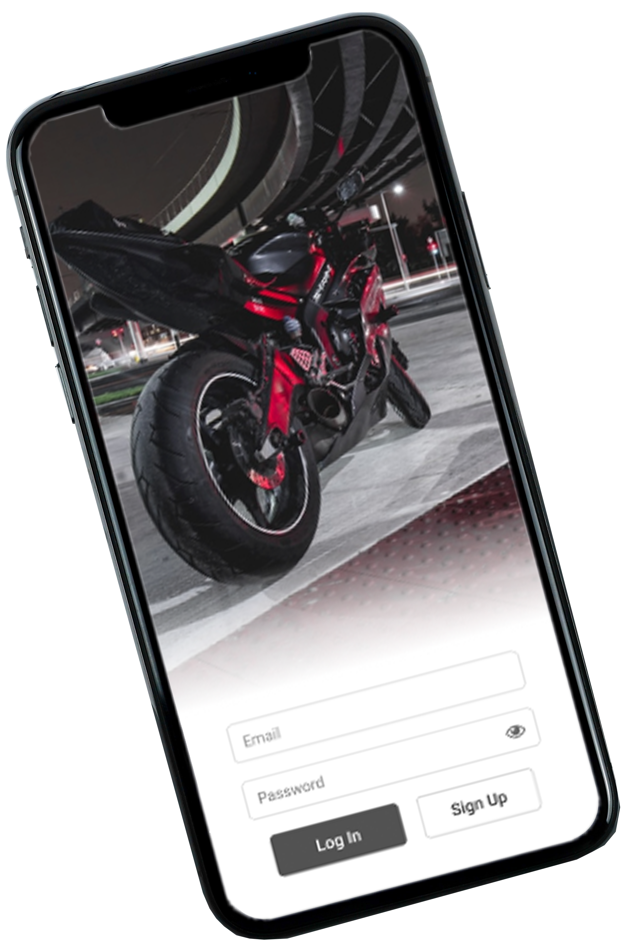
Design: Iteration
Most notable from the first round of testing was the need for a simplified colour picker on the new task screen and the prototype was too low-fidelity for the user to automatically recognise all the items on the screen.
My second round of testing was using the high-fidelity prototype and users were quite pleased with the look and feel of the design. The improvement made after this round of testing was to the login screen, users were not finding the sign-up button very easily so I upgraded the button from tertiary style to secondary. This surprised me as it was initially recommended to use a tertiary button to avoid users not knowing where to tap.

Slide 9
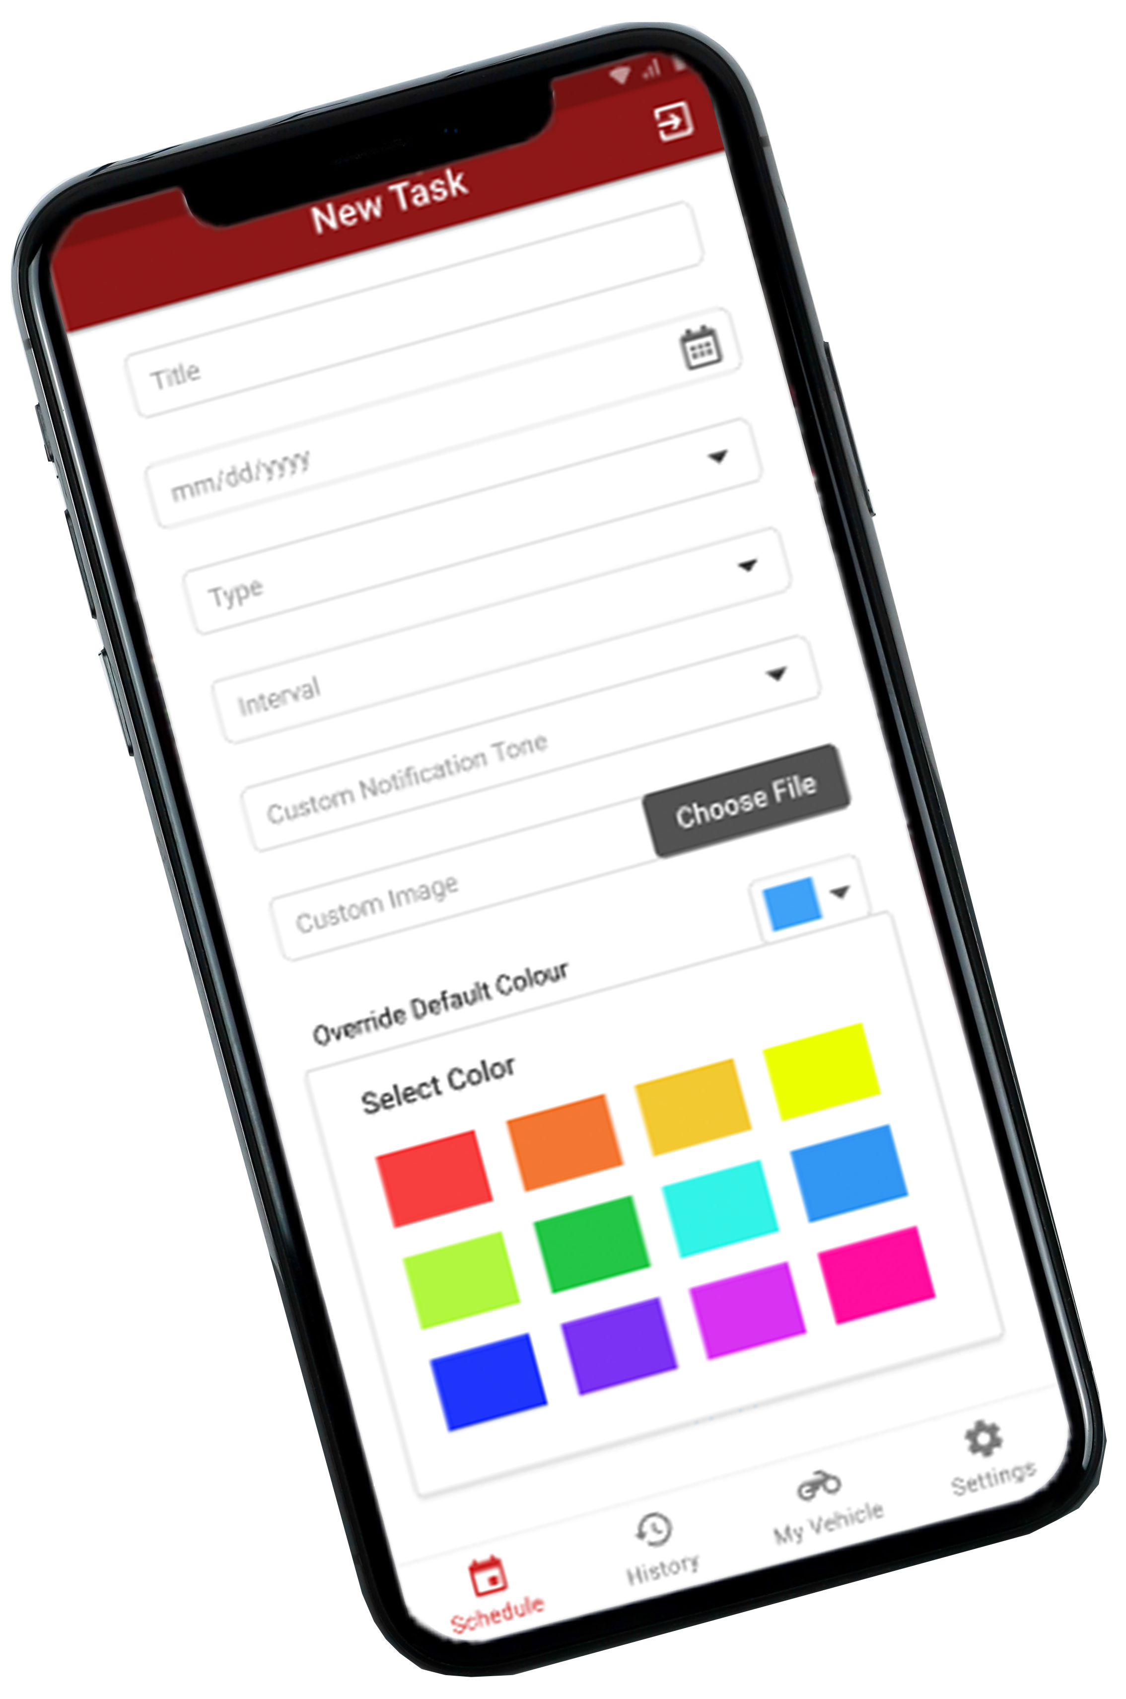
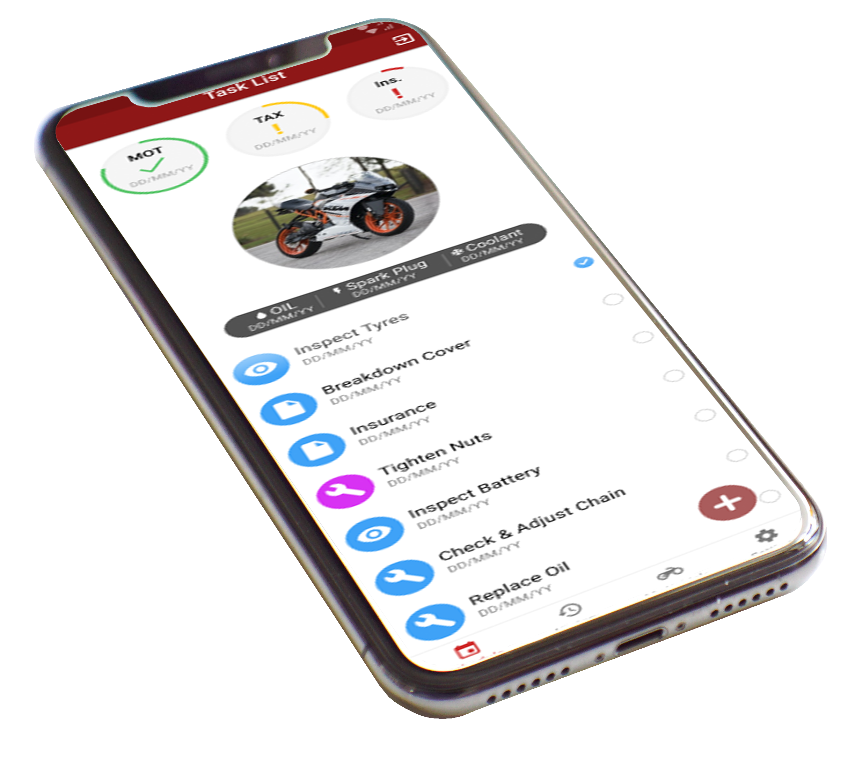
Solution & Impact Overview
Here is the final version, from user feedback and accessibility reviews I was able to find a few areas I could improve on. The top section has reduced to 3 items instead of 4 to maximise on space. Fonts in some areas were enlarged and contrast improved. I implemented the simplified colour picker and improved the sign up button.
The user testing proved invaluable in designing this app and I have had people interested in buying the app once released.
This was an enjoyable and enlightening project which has given me a lot of extra skills I can apply to my career.
Click here to view the final prototype.

Slide 10
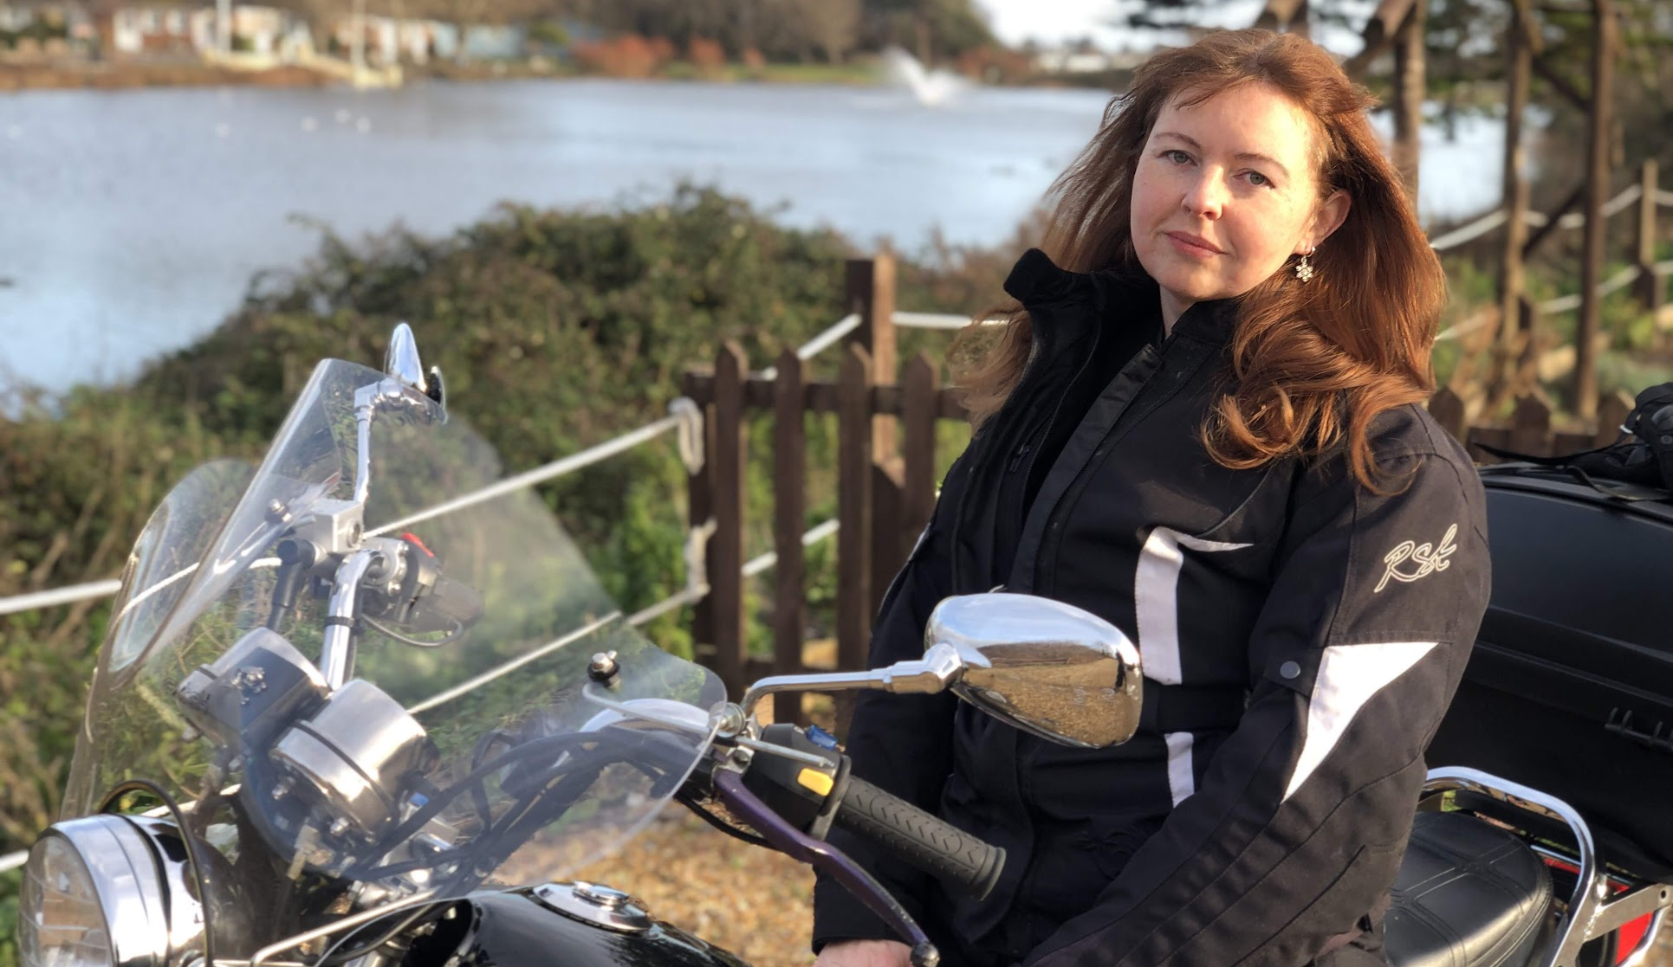
About Me
I always planned on a career in Graphic Design but after my college course fell through due to under-subscription I spent some time as a factory worker before starting a family. Once the children were old enough, I resumed my path in Graphic Design and incorporated Web Design as a hobby. Developing these skills on a community site I began to make a little money from my designs and eventually had enough experience to get a job as a developer writing software for in-flight entertainment units.
I find it very rewarding when people enjoy using what I have created and with my recent UX course I now have more ways to improve the experience for my users. I truly enjoy making people happy through my work and also as a team mate.
I continue to learn and develop my skills in a variety of languages and methodologies, and when I am not working I am out with my family and friends on our motorbikes, going for walks, playing computer games, playing with my cat (when he’s in the mood) and looking after my tropical aquarium.

